Slide 1
CatchAndRetry Extending Exceptions to Handle Distributed Systems Failure and Recovery
Emre Kıcıman, Ben Livshits, and Madanlal Musuvathi
Microsoft Research
Fluxo Project

Slide 2

Motivation: Failures in Distributed Systems
Failures are a fact of life
Especially in distributed systems
Developer has to deal with that possibility
CatchAndRetry – make error recovery easier

Slide 3
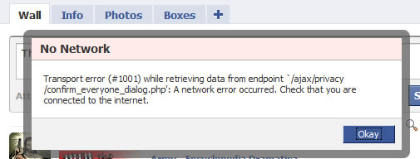
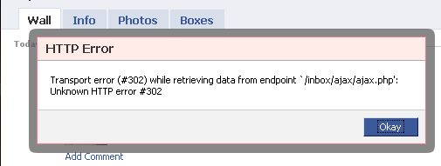
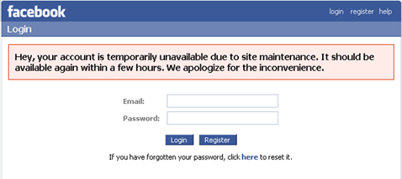
Availability Errors
Network disconnects
Hardware failures
Performance stutters

Slide 4
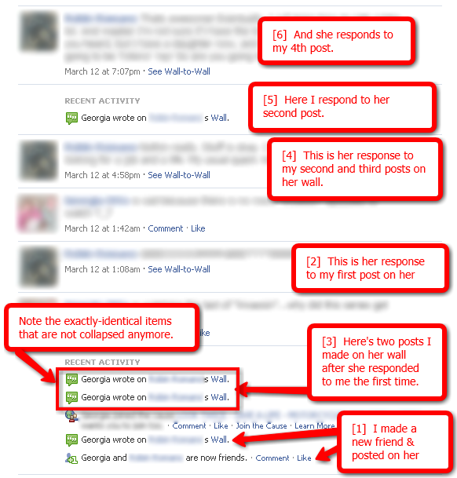
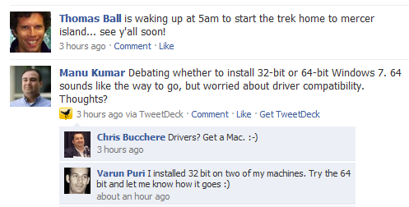
Data Staleness and Consistency

Slide 5
How to Recover?
Ignore and continue optimistically
Retry (N times)
Retry with different parameters
Schedule the retry for a later time

Slide 6
CatchAndRetry Illustrated

Slide 7
Basic retry
try {
Console.WriteLine("reading file...");
// code to read a file from the network
...
} catch( StalenessException e ) {
// wait 5 seconds before retrying
Thread.Sleep(TimeSpan.FromSeconds(5));
Console.WriteLine("about to retry...");
retry; // retry once
Console.WriteLine("retried the read");
}

Slide 8
Retry Multiple Times
try {
Console.WriteLine("reading file...");
// code to read a file from the network
...
} catch( StalenessException e ) {
// wait 5 seconds before retrying
Thread.Sleep(TimeSpan.FromSeconds(5));
Console.WriteLine("about to retry...");
retry 3; // retry thrice
Console.WriteLine("retried the read");
}

Slide 9
Handle Retry Failure
try {
Console.WriteLine("reading file...");
// code to read a file from the network
...
} catch( StalenessException e ) {
// wait 5 seconds before retrying
Thread.Sleep(TimeSpan.FromSeconds(5));
Console.WriteLine("about to retry...");
retry 3; // retry thrice
Console.WriteLine("retried the read");
} fail {
Console.WriteLine("retry failed");
}

Slide 10
Recovery from Multiple Exceptions
try {
ReadData();
} catch(NetworkConnectivityException e) {
Thread.Sleep(TimeSpan.FromMilliseconds(5));
retry 5;
} fail {
Console.Writeline("network failure");
} catch(StaleDataException e) {
RefreshData();
retry 10;
}

Slide 11
Parametrized Retry
int x = 10, y = 100, z = 200;
try(x,y) {
z = x + y;
} catch(Exception ex) {
// retry twice with x=5
retry(x=5), 2;
}

Slide 12
Re-scheduled Retry
try {
// do something
} catch(
AvailabilityException e, RetryFunction r)
{
// try block asynchronously
scheduleForLater(r);
}

Slide 13
De-sugaring
A a;
try(a){
T;
} catch(Exception1 ex1){
P1;
retry 3;
Q1;
} fail {
F1;
} catch(Exception2 ex2){
P2;
retry(a=a2);
Q2;
} fail {
F2;
} finally{
R;
}
Try block becomes a parameterized delegate
Every retry statements leads to a retry counter
Possible to alternate between retries
Gives an upper bound on the number of retries

Slide 14
Facebook Examples

Slide 15
Getting a Friend List in FB (staleness)
try {
List<Person> f = friends.Get(person, staleness);
} catch (StalenessException ex){
Aspects.registerAspect(Facebook.PingServer,
new Task(delegate(){
// refresh from server
friends.Refresh(person);
})).waitForCompletion();
// just retry
Console.WriteLine("Retryng after update...");
retry;
}

Slide 16
Server Availability
string protocol="HTTP";
try(protocol){
SendMessage(friend, message, protocol);
} catch(AvailablityException ex){
Thread.Sleep(TimeSpan.FromSeconds(5));
retry(protocol="HTTP");
}

Slide 17
CatchAndRetry Summary
Extensions of traditional try/catch/finally
Focus on common types of distributed systems errors
Availability
Consistency
Present our vision for extending C#/Java/JavaScript
But also more experimental systems (Fluxo)

