Slide 1
A Microkernel API for Fine-grained Decomposition
Sebastian Reichelt, Jan Stoess, Frank Bellosa

Slide 2
OS Decomposition
Data location?
Data transfer?
Split state?
System knowledge?
Microkernel
Kernel
TCP/IP stack
Threads
Threads
Address spaces
Address spaces
IPC
Packets
IPC
Ease of development?
Reuse?
Granularity?
Component model
Device driver
Threads
Threads
Address spaces
Interfaces
Microkernel
IPC
Notes:
What do we mean by decomposition?
0. Instead of a monolithic kernel ...
1. ... we want to turn system components into servers (security, robustness, extensibility, reusability, ...)
2. Usually existing microkernel, API with abstractions/mechanisms
3. Component on top, own abstractions
4. Microkernel abstractions leak into component model ...
5. ... and into components/servers (new problems: deadlocks, data location, batches, ... – fine if e.g. extreme concurrency is the goal, but harmful for decomposition)
6. Extra logic, glue code (more servers → much more complex interaction)
To solve these problems ...

Slide 3
Our Approach
Data location?
Data transfer?
Split state?
System knowledge?
Microkernel
Servers
Servers
TCP/IP stack
Local objects
References
Local objects
References
Packets
Function calls
Function calls
Component model
Component model
Device driver
Interfaces
Microkernel
Notes:
... we take the reverse direction.
0. When decomposing, we have certain abstractions in mind (more general than threads etc.) ...
1. ... which are independent of these implementation-specific questions
2. Define component model based on those
→ Everything on top of component model
→ Why need additional API?
3. Microkernel implements model directly (must be simple and expressive)
→ Model becomes API (different from usual microkernels)
Does it make a difference ...?

Slide 4


Designing for Decomposition
Existing microkernels:
Microkernel
Task
Server
Task
Create thread
Threads
Address spaces
Task
IPC
Send IPC
Task
Receive IPC
Our microkernel:
Component model
Component
Component
Server
Servers
Provided interface
Local objects
References
Component
Required interfaces
Component
Threading options
Notes:
Yes: leads to different system structure.
0. Want to write a server, code solving particular problem
1. Microkernel API tells us what to do
2. When loaded: at fundamental level, one of many tasks that run and communicate via IPC
→ Distributed system
3. Component model specifies what server looks like
→ Compile into file → a bit of code dealing with problem, plus information (e.g. thread-safe)
4. When loaded: connected according to interfaces, function calls
→ Still just a component, no task
Will only work if model covers everything we need to write a server. One example ...

Slide 5
Reference Management
Microkernel
Notes:
0. Lots of dependencies between servers (especially in fine-grained system)
1. Some maintain state for others
2. If a server dies, we want the state to disappear
Cannot be solved by individual servers.
Typical microkernel knows about event, but not dependencies.
Microkernel implementing component model is different ...

Slide 6
Reference Management
Client
TCP/IP stack
open
connection
TCP connection
send packet
Microkernel
Notes:
0. References: local, opaque handles, managed by kernel, used for calls
1. Server will maintain state just for us, e.g. connection data
2. Create local object implementing interface, return reference
3. Call interface function
4. What if client dies?
5. References managed by kernel → Causes destruction of local object
A lot more relevant details – challenge: expressiveness/simplicity
Built prototype to work out entire component model ...

Slide 7
Prototype
Multi-server OS (~4 man-months)
  Basic servers (memory, scheduling, ...)
  Drivers (standard PC hardware, PCI, Ethernet)
  Decomposed TCP/IP stack
  Linux ABI implementation (partial)
Kernel (~2 man-months)
  IA-32 implementation
  Servers in kernel mode
Linux
lwIP
Evaluation: granularity, reuse, performance

Slide 8
Granularity
Size of a server:
 | Minimum | Maximum | Average
Lines of code | 27 | 1363 | 306
Bytes | 280 | 13588 | 2907
As fine-granular as desired
Linux ABI layer

Slide 9
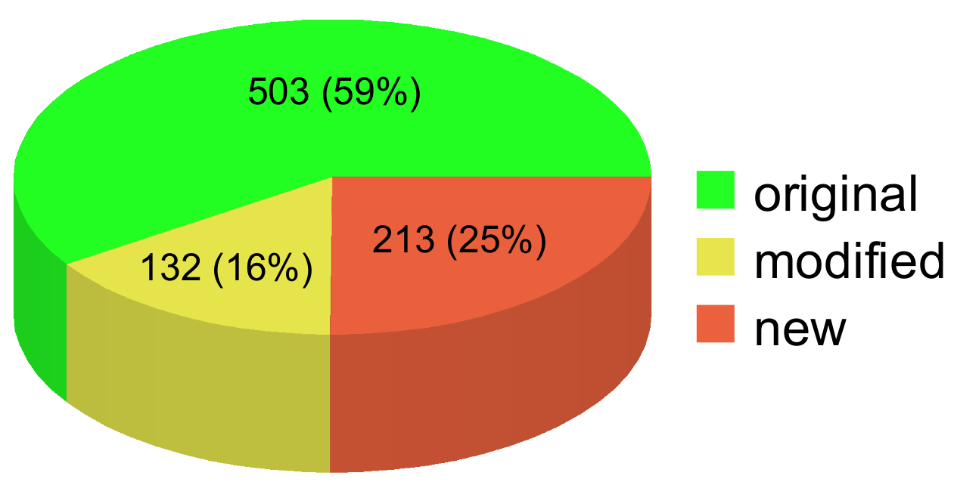
Reuse
RTL-8139 driver ported from Linux (~1 man-month):
Reuse possible with little effort
lines of code
e.g. calls via interfaces
instead of directly
queue-based
packet processing

Slide 10
Performance
Operation | Pentium 4 | Core 2
Cross-component call/return (kernel mode) | 46 | 23
Function call/return | 11 | 9
Low performance overhead
Operation | Pentium 4 | Core 2
Cross-component call/return (inter-AS) | 1965 | 771
L4Ka round-trip IPC | 2262 | 1052
cycles

Slide 11
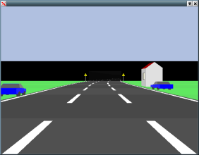

Conclusion
Microkernel APIs enforce system structure
  Existing APIs → distributed systems
  Development, reuse, and granularity problems
Our approach: component model as API
  More general abstractions related to decomposition
  (servers, interfaces, calls, references, local objects, ...)
  Derived microkernel design
Networking-capable prototype OS
Good granularity and reuse, promising performance
http://oosys.sourceforge.net/
Demo today

Slide 12
Example
File VFS::getFile(const char *name, Size nameSize) {
for (unsigned int i = 0; i < fsCount; i++) {
if (fs[i].matches(name, nameSize)) {
return fs[i].ref->getFile(name + fs[i].nameSize,
nameSize - fs[i].nameSize);
}
}
THROW(EFileNotFound);
}
automatic reference counting
automatic locking/unlocking

