Slide 1
Assessing the Scalability of Garbage Collectors on Many Cores (Funded by ANR projects: Prose and ConcoRDanT)
Lokesh Gidra Gaël Thomas
Julien Sopena Marc Shapiro
Regal-LIP6/INRIA

Slide 2
Introduction
Why?
MREs are ubiquitous!
GC, a vital component of it ⇒ performance is critical?
Hardware is more and more multi-resourced.
Are GCs scaling with such hardware?
Current solutions not evaluated on true many-cores!
What?
Assesses GC scalability : Empirical Results.
Possible factors affecting the GC scalability.

Slide 3
Multi-Node Architecture
C0
C1
C5
C0
C1
C5
15
L2
L2
40
L2
L2
L2
L2
L3
L3
315
125
MC
To other nodes
MC
DRAM
DRAM
Remote access >> Local access
Our machine has 8 nodes with 6 cores each

Slide 4
Parallel Copying Garbage Collection
Mutator Threads
GC Threads
Application
Time
Pause
Time
Total Time
Live Object
Dead Object
From Space
To Space

Slide 5
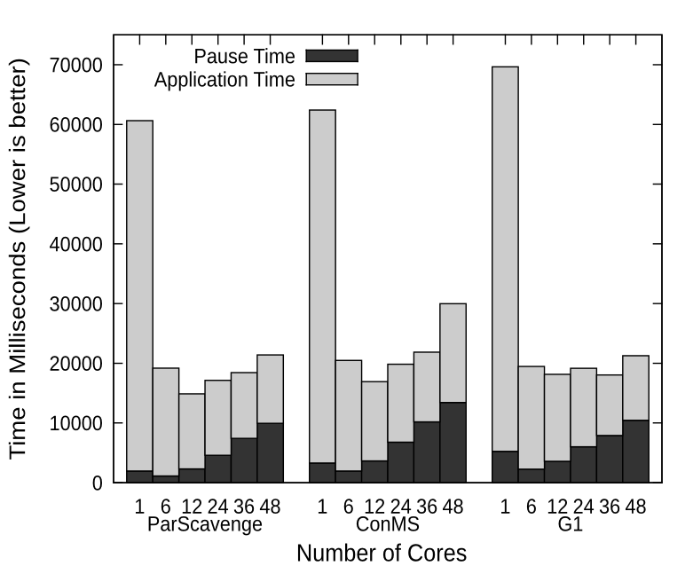
GCs effect on Application Scalability (Lusearch)
Mutator Threads = GC Threads = Varying Number of Cores
Up-to 6 cores:
3X performance improvement.
More than 6 cores:
No improvement in total time.
Proportion of pause time increases up-to 50%.

Slide 6
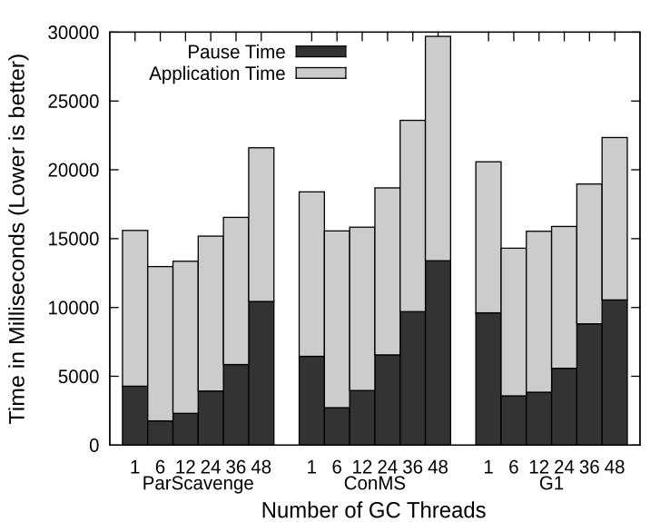
GC Scalability (Lusearch)
Mutator Threads = Cores = 48 and, Varying Number of GC Threads
Pause time increases with GC threads ⇒ Negative Scalability!

Slide 7
1. Remote Scanning
GC Threads
Node 0
Node 1
87.7% scans were remote!
Node 2
Random (Default) object allocation
GC0
GC1
GC2
GC3
Node 3
Live Object
Dead Object
From Space
To Space

Slide 8
2. Remote Copying
GC Threads
Node 0
Node 1
82.7% copies were remote!
Node 2
GC0
GC1
GC2
GC3
Node 3
Live Object
Dead Object
From Space
To Space

Slide 9
3. Load Balancing
Based on work stealing technique.
1 task queue per GC thread.
Task Queue
Owner: Push and Pop
Other GC Threads: Steal (Pop)
Shared Variable: size (task queue size)
Highly unbalanced load:
Requires a lot of stealing.
Keep doing until all are done.
Performance Impact: ≥ 2-4 cache misses/stealing!
33.3% improvement in pause time by disabling it!

Slide 10
Conclusion
GC does affect application’s scalability ⇒ it matters!
GC doesn’t scale with the hardware!
Bottlenecks:
Remote Scanning
Remote Copying
Load Balancing
Future Work:
Fix the bottlenecks → does it help GC to scale?

Slide 11
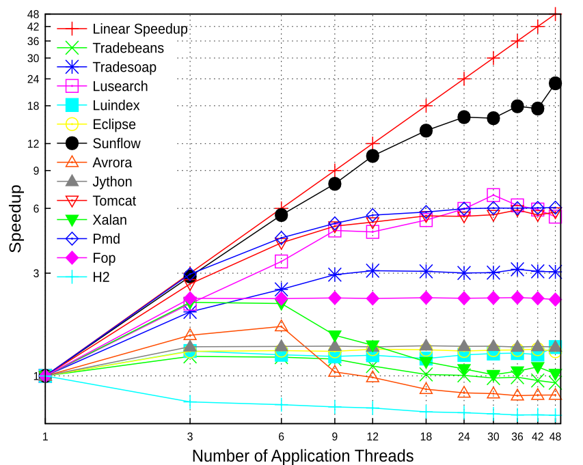
DaCapo Benchmarks’ Scalability

Slide 12
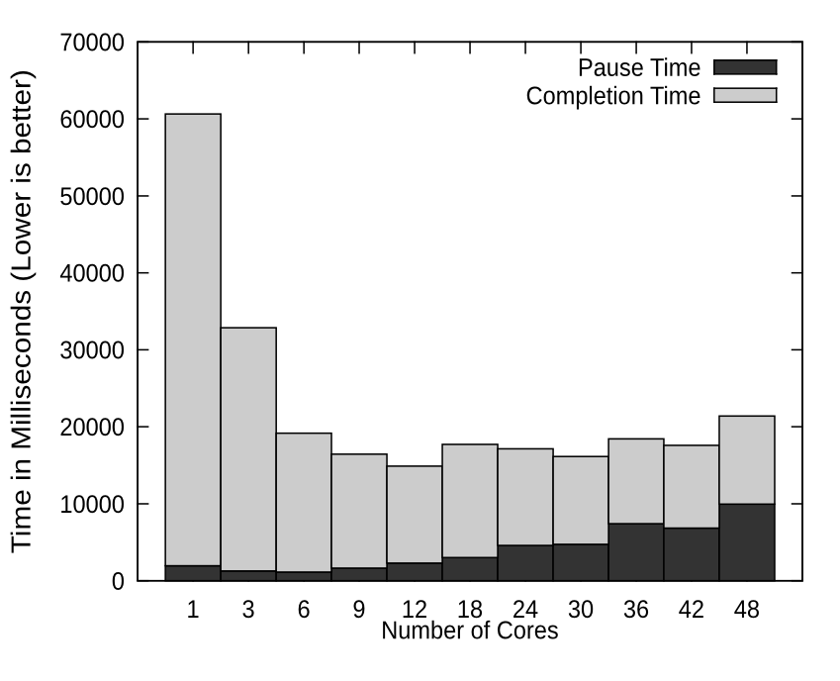
Revisiting App. (Lusearch) Scalability…

