Slide 1

Panic Recovery in Rust-based Embedded Systems
Zhiyao Ma, Guojun Chen, Lin Zhong
Efficient Computing Lab
Yale University

Slide 2

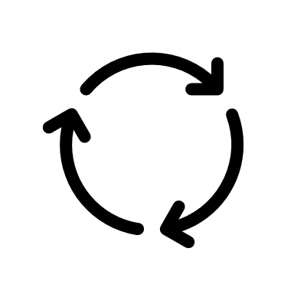


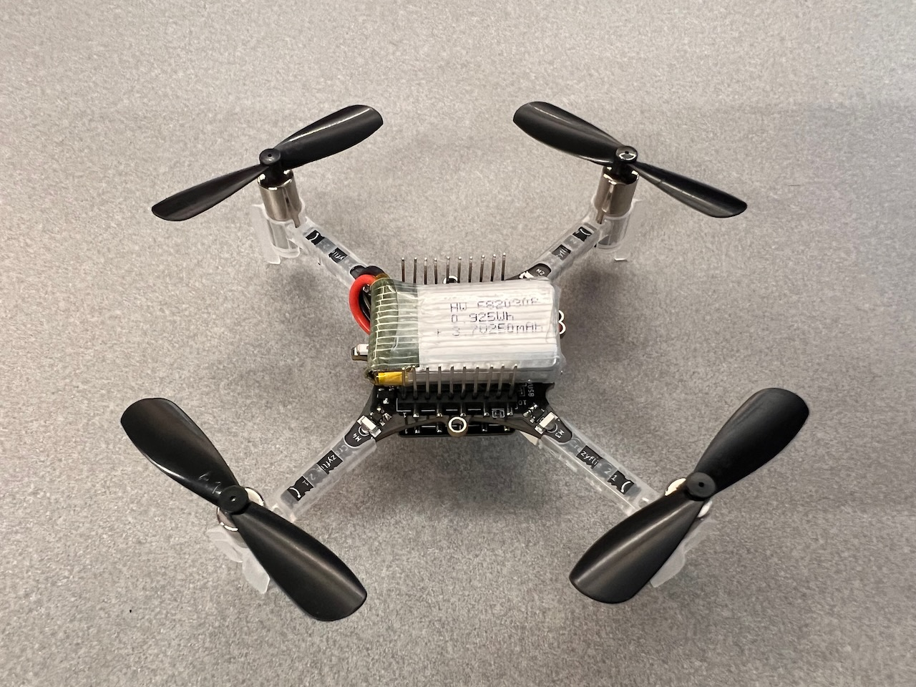
Tasks May Crash Due to (Language) Exception
Language exception
Rust panic, C++ std::runtime_error, etc.
Various sources of exception
Bugs in program code
Failed assertions
Transient hardware error
Embedded systems pose greater challenges
Unattended
Mission critical

Slide 3
Recover by Unwinding & Restarting
Reclaim resources by unwinding a task’s stack.
Force function returns out of main().
Destruct initialized objects.
Resume execution by restarting the task.
Run again from main().
Applicable to soft real-time systems.

Slide 4
How Stack Unwinding works

Slide 5
Unwinder forces return until catch_unwind
fn f() {
catch_unwind(|| g());
// Other code
}
fn g() {
let x = Box::new(42);
h();
// Other code
}
fn h() {
let r = cur_task_ref();
panic!();
// Other code
}
f()
Heap
g()
h()
OS
Resource
Stack
Notes:
Function call chain f() -> g() -> h()
A variable in g()’s stack frame owns a heap allocated object.
A variable in h()’s stack frame owns an OS resource.

Slide 6

Unwinder forces return until catch_unwind
fn f() {
catch_unwind(|| g());
// Other code
}
fn g() {
let x = Box::new(42);
h();
// Other code
}
fn h() {
let r = cur_task_ref();
panic!();
// Other code
}
f()
Heap
Invoke LPs
Restore Regs
Landing Pad
g()
Stack
Unwinder
Landing Pad
h()
OS
Resource
Exception
Table
Landing Pad
Stack
Notes:
When panic occurs in h(), the unwinder is invoked.
The unwinder refers to the exception table to know the landing pad of the current function.
The landing pad is a piece of code for resource cleanup or to resume execution.
For h() in this situation, it’s for resource cleanup. The object in h()’s stack frame will be destructed and the OS resource will be released.
After a resource cleanup landing pad finishes, it will jump back to the unwinder.
The unwinder refers again to the exception table again to restore registers, after which the register context will represent the previous stack frame, i.e., g()’s.
Now the content in h()’s stack frame is completely useless. We can treat it as uninitialized memory.

Slide 7
Unwinder forces return until catch_unwind
fn f() {
catch_unwind(|| g());
// Other code
}
fn g() {
let x = Box::new(42);
h();
// Other code
}
fn h() {
let r = cur_task_ref();
panic!();
// Other code
}
f()
Heap
Invoke LPs
Restore Regs
Landing Pad
g()
Stack
Unwinder
Landing Pad
OS
Resource
Exception
Table
Landing Pad
Stack
Notes:
The unwinder continues with the same logic for g().

Slide 8
Unwinder forces return until catch_unwind
fn f() {
catch_unwind(|| g());
// Other code
}
fn g() {
let x = Box::new(42);
h();
// Other code
}
fn h() {
let r = cur_task_ref();
panic!();
// Other code
}
f()
Heap
Invoke LPs
Restore Regs
Landing Pad
Stack
Unwinder
Landing Pad
OS
Resource
Exception
Table
Landing Pad
Stack
Notes:
Finally, for f(), the landing pad is not for cleanup, but for resuming normal execution flow.

Slide 9
Unwinder forces return until catch_unwind
fn f() {
catch_unwind(|| g());
// Other code
}
fn g() {
let x = Box::new(42);
h();
// Other code
}
fn h() {
let r = cur_task_ref();
panic!();
// Other code
}
f()
Heap
Invoke LPs
Restore Regs
Landing Pad
Stack
Unwinder
Landing Pad
OS
Resource
Exception
Table
Landing Pad
Compiler Generated
Stack
Notes:
Compiler generates the exception table and landing pads.

Slide 10
Challenges of Unwinding on Embedded Systems
Storage overhead
Unwinder logic, landing pads, exception table
Up to 5x size increase
Rust panic’s simplicity: only Exception type, always fatal, no re-throw, etc.
Arm EHABI more compact exception table format
Performance overhead
Unwinder interpreting exception table
Up to 1000x slow down
Concurrent restart-able task abstraction (facilitated by Rust)

Slide 11
Hopter: An Embedded OS Capable of Recovering from Panic

Slide 12
RCB Supports Recovery from Panic
Reliable Computing Base (RCB)
Can recover panics from components above RCB
IRQ X
IRQ Y
Application
Task A
Task B
Task C
IRQ Z
Sync
Primitives
Mutex
Semaphore
Channel
Context Switch
Mem Allocator
Stack Unwinder
RCB

Slide 13

Acceleration by Concurrent Task Restart
Start a cloned task from entry() while unwinding the panicked one.
Unwinding uses otherwise idle CPU time.
entry()
foo()
bar()
entry()
foo()
bar()
Reduced Priority
Task A’
Task A

Slide 14
Restartable Task Abstraction
pub fn create_restartable_task<F, A>(
entry_closure: F, entry_argument: A,
stack_size: usize, priority: u8) where F: FnOnce(A) + Clone + Send + Sync + 'static,
A: Clone + Send + Sync + 'static, { ... }
Application
Developer
Supply
Clone: safe to duplicate
Send: safe to move across task context
Sync: safe to access from multiple task context
Notes:
Application developers supply the entry closure and its optional argument (can be just () if no argument) to create a restartable task.
The interface has trait constraint on the supplied closure and argument, so that the OS can safely perform the following:
Copy the entry closure (which may contain some enclosed environment) and the argument
Move the closure and the argument to a new task context
Access the closure and argument (and what they may in turn reach) from multiple task context

Slide 15
Restartable Task Abstraction – Continued
fn restartable_task_entry_trampoline<F, A>(
entry_closure: &F, entry_argument: &A)
where ..., {
catch_unwind_with_arg(
entry_closure.clone(),
entry_argument.clone());
}
OS catches the panic outside of task’s entry function.
Notes:
A wrapper function is placed outside the supplied entry closure.
The wrapper function is part of the OS. This is the boundary function between the OS and the application task.
The OS catches the panic after the unwinding goes out of the entry function.

Slide 16
Priority Inheritance During Unwinding
trampoline()
fn trampoline() {
catch_unwind(|| entry());
// Other code
}
static S: Mutex<T>
= Mutex::new(T::new());
fn entry() {
let s = S.lock();
// Work on `s`
panic!();
}
trampoline()
Unwinding
Running
Priority: Lowest
entry()
entry()
Priority: Medium
s
s
Stack
Stack
Task A
Task A’
Notes:
When a task panics, its priority is reduced to the lowest during unwinding.
Priority inversion may occur if the panicked task being unwound holds a resource that prevents the restarted task from execution.

Slide 17
Priority Inheritance During Unwinding
trampoline()
fn trampoline() {
catch_unwind(|| entry());
// Other code
}
static S: Mutex<T>
= Mutex::new(T::new());
fn entry() {
let s = S.lock();
// Work on `s`
panic!();
}
trampoline()
Unwinding
Running
Priority: Medium
entry()
entry()
Priority: Medium
s
s
Stack
Stack
Task A
Task A’
Notes:
When contention occurs, the unwinding task will inherit the priority of the normally executing one.

Slide 18
Priority Inheritance During Unwinding
trampoline()
fn trampoline() {
catch_unwind(|| entry());
// Other code
}
static S: Mutex<T>
= Mutex::new(T::new());
fn entry() {
let s = S.lock();
// Work on `s`
panic!();
}
trampoline()
Unwinding
Running
Priority: Lowest
entry()
Priority: Medium
s
Stack
Stack
Task A
Task A’
Notes:
When contention is resolved, the priority of the unwinding task will be reduced back to the lowest.

Slide 19
Rust Facilitates Concurrent Task Restart
Rust precludes race conditions.
Between panicked and restarted tasks, accessing static variables.
Safe Rust disallows mutable static variables and requires Sync trait.
➔ Must use Mutex around mutable static variables or atomic types
➔ Mutex priority inheritance works as normal

Slide 20
Rust Facilitates Concurrent Task Restart
Rust precludes race conditions.
Between panicked and restarted tasks, accessing static variables.
Safe Rust disallows mutable static variables and requires Sync trait.
➔ Must use Mutex around mutable static variables or atomic types
➔ Mutex priority inheritance works as normal
Rust disambiguates fatal exception.
Rust panic is always fatal.
C++ exception not always fatal: std::stoi() throws std::invalid_argument().
➔ Concurrent restart only makes sense for fatal exception.

Slide 21
Evaluation with a Flying Drone
An Example of Soft Real-time System

Slide 22
Running Flight Control Application on Hopter
horizonal
displacement
PMW3901
Optical Flow
State Estimator
Data
Channels
Crazyflie 2.1
COTS miniature drone
Originally with FreeRTOS
VL53L1x
Laser Time
of Flight
height
GPIOs
6-axis
inertial
position, velocity,
attitude
BMI088
Accelerometer
& Gyroscope
Control
Stabilizer
control
command
DMA
Data write
Commander
Motors
STM32F405RG
Flight control application overview
Tasks
2 data read
1 start transfer
Peripherals
Sensor
DMA
Sensor Task
4 invoke
3 data write
Data Buffer
Objects
DMA IRQ
Handler
5 signal
Semaphore
STM32F405RG
Interrupt
Handlers
PendSV
Handler
Sensor task zoom in

Slide 23
Can Sustain Panics from Task & IRQ Handler
horizonal
displacement
PMW3901
Optical Flow
State Estimator
Data
Channels
Put panic!() in task’s code
Put panic!() in PendSV handler
VL53L1x
Laser Time
of Flight
height
GPIOs
6-axis
inertial
position, velocity,
attitude
BMI088
Accelerometer
& Gyroscope
Control
Stabilizer
control
command
DMA
Data write
Commander
Motors
STM32F405RG
Flight control application overview
Tasks
2 data read
1 start transfer
Peripherals
Sensor
DMA
Sensor Task
4 invoke
3 data write
Data Buffer
Objects
DMA IRQ
Handler
5 signal
Semaphore
STM32F405RG
Interrupt
Handlers
PendSV
Handler
Sensor task zoom in

Slide 24
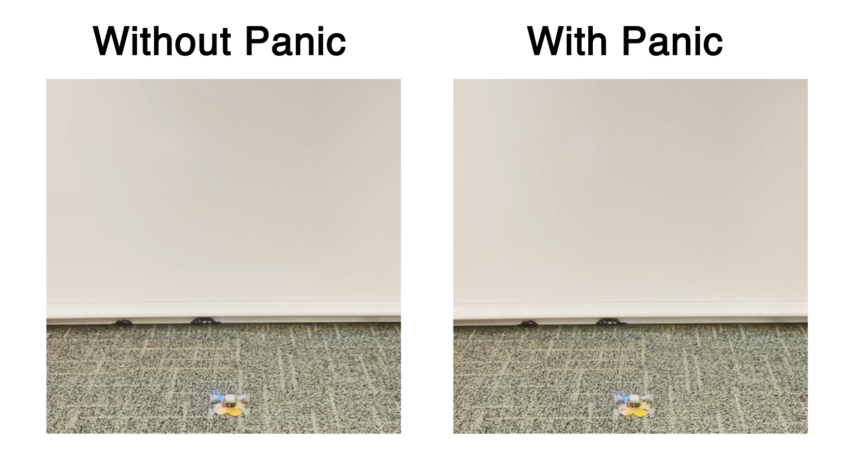
Notes:
Panic triggered in flow task (optical flow based horizontal movement sensor task)
Triggered at one-second intervals
When the red LED blinks, a panic is triggered.
Commands to the drone:
Constant thrust for 1 second to take off
Maintain height at 0.5m above the ground

Slide 25
Price for unwinding
2.6% more CPU usage after enabling unwinding
Precluded compiler optimizations
26.0% storage overhead
Unwinder logic, landing pads, exception table

Slide 26
Conclusions
Panic recovery via unwinding is feasible on embedded systems.
Soft real-time constraint can be met.
Rust reduces unwinder complexity.
Rust facilitates concurrent task restarts.
2.6% CPU overhead, 26.0% storage overhead when flying a drone.

